Slide 1
BCOG 100
The Evolution of Neurons
Lecture 3: From Neurons to Brains and Behavior

Slide 2
Reading Check 4-3
Password: potential
Question: How’s the class going so far?

Slide 3
From Neurons to Brains and Behavior
Last Time
Why animals evolved neurons, and what they could do with them
Today
Neural nets to neural circuits
Radial vs. bilateral body plans
Steering and simple brains
Valence & internal states
Neurotransmitters in behavior
Notes:
Last time, we saw how neurons evolved and how they work —
spikes, synapses, neurotransmitters, and the balance of excitation and inhibition.
Today, we’re going to take the next step in the story: how those neurons became organized into brains.
Our roadmap:
We’ll look at how the first complex nervous systems were simple neural networks, without a lot of structure or organization.
Then, we’ll look at how body plans — radial vs. bilateral symmetry —
created new opportunities for steering and decision-making, but required more organized neural structure.
Then, we’ll explore simple brains, using worms as a model.
We’ll talk about the idea of valence — good vs. bad signals — and how internal states like hunger shift behavior.
We’ll look at neurotransmitters not just in worms, but also in humans — how the same chemicals shape our moods, motivations, and even mental health disorders.
Finally, we’ll end with a preview of next week: how circuits of neurons can actually implement logic

Slide 4
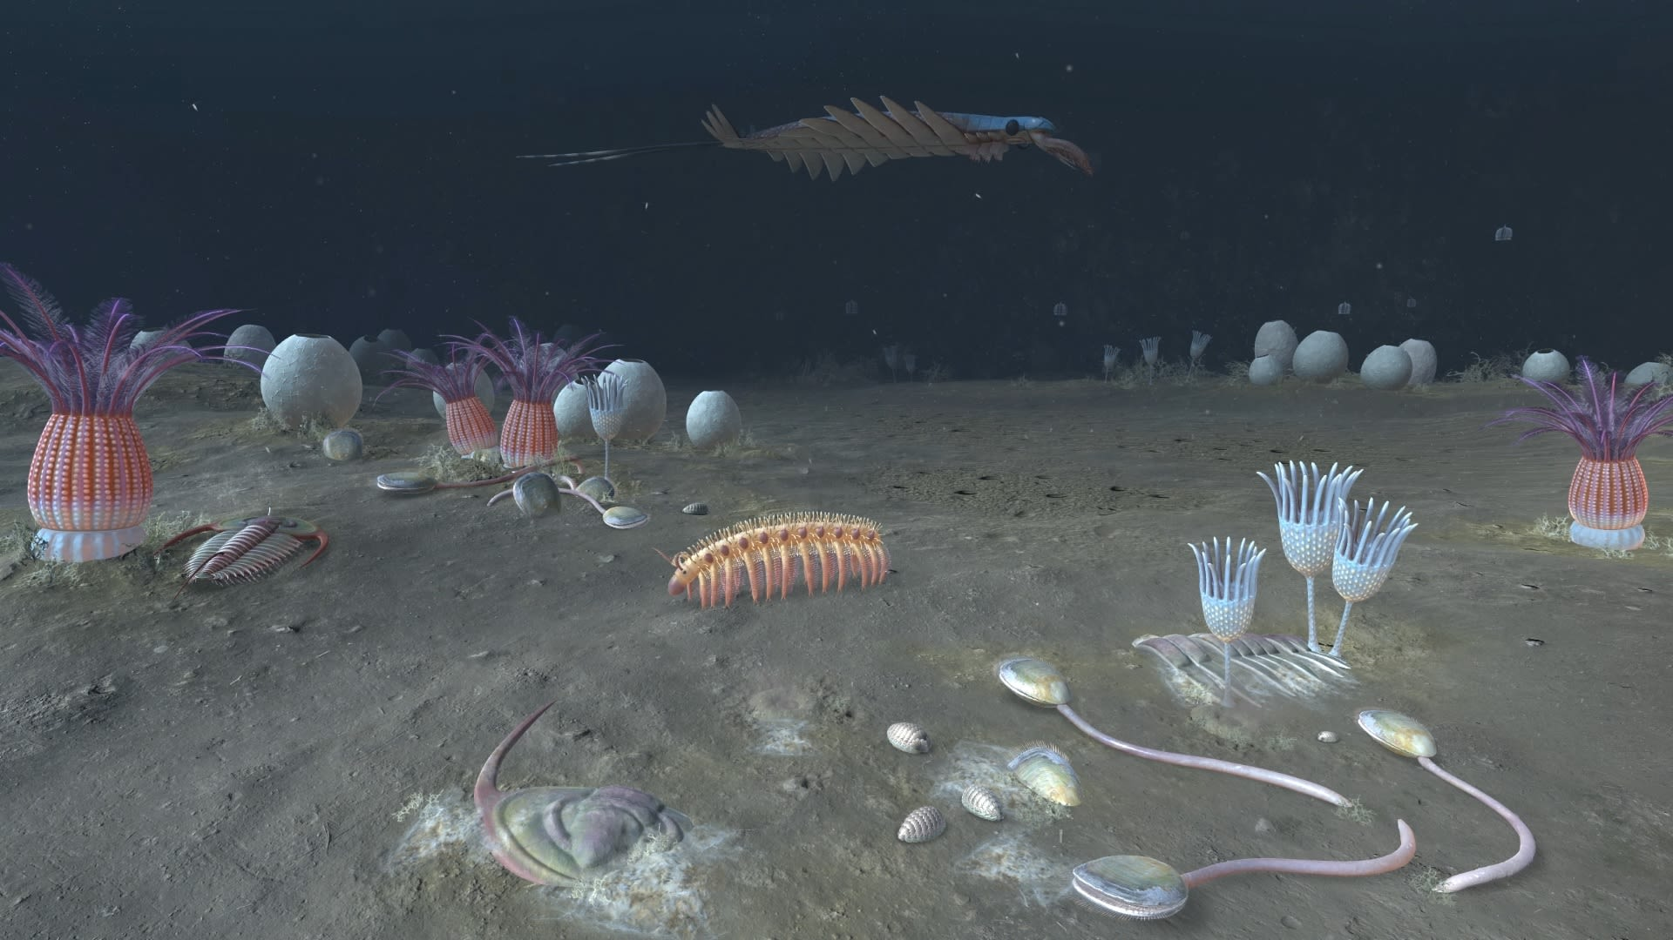
From Neurons to Brains and Behavior
The First Animals in an Oxygen-rich World
~600 million years ago
Common ancestor of animals
Features:
Multicellular
Gut + muscles + simple nerve net
Oxygen = energy for new possibilities
Notes:
About 600 million years ago, after oxygen transformed the planet, the first true animals appeared.
They were multicellular, with a simple gut for digesting food, muscles for movement, and a nerve net for coordinating those muscles.
This ancestor represents the dawn of animal life as we know it.
Oxygen gave these animals an opportunity:
for the first time, there was enough energy to power larger bodies, more active lifestyles, and more complex behaviors.
But it also presented a dilemma: what’s the best way to use that energy? Different lineages came up with different answers.
And here is where we see something really fascinating.
Today, we have a vast range of different animals with different behavioral capabilities.
But the structure of a neurons is the pretty much the same in all organisms alive today.
They have dendrites with neurotransmitter receptors that can excite or inhibit action potentials, which release neurotransmitters.
The big differences between a jellyfish and a worm and a dinosaur and a human are much less about how the individual neurons work.
They are mostly about how those neurons are organized, both in local circuits and in larger brain structures – leading to big behavioral differences.

Slide 5
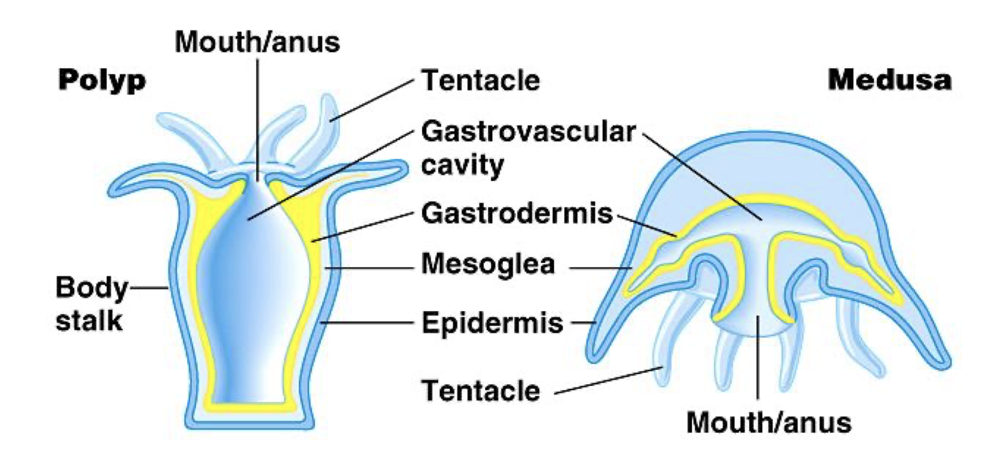
From Neurons to Brains and Behavior
Different Animal Strategies
Same starting point, different paths
Cnidarians: nerve nets, two strategies
Corals/anemones → stationary
Jellyfish/hydras → mobile (muscle + nerve net)
Different trade-offs, same ancestry
Notes:
From that common ancestor, different animal lineages pursued different strategies.
In the cnidarians — the group that includes corals, anemones, jellyfish, and hydras — we see two contrasting solutions:
Corals and anemones stayed stationary, using tentacles to catch prey that drifted by.
Jellyfish and hydras went mobile, using their muscles and nerve nets to actively move through the water.
Both strategies work — they’re still around today.
But notice: movement required more energy and more coordination.
That’s where neurons began to shine, especially in lineages that invested in mobility.

Slide 6
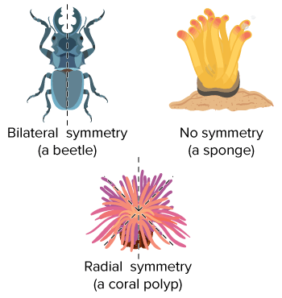
From Neurons to Brains and Behavior
Radial vs. Bilateral Symmetry
Radial: same all around (jellyfish, corals) Can’t steer precisely
Bilateral: front/back, left/right Supports sensors + directed movement
Notes:
Radial symmetry means the body is the same in all directions.
Animals like jellyfish or corals can sense and respond from any side.
That works if you’re drifting in currents, or pulsing gently up and down, but it makes steering hard.
If your body is the same all the way around, you don’t have a ‘front end’ to point toward a target.
You can respond to touch or light, but you can’t easily choose a direction and move consistently in it.
Well you can, but the coordination problem is much more difficult.
Bilateral symmetry solved this.
With a clear front and back, animals could put sensors at the front, muscles along the sides, and a control center in the head.
This made precise, goal-directed movement possible — a huge step forward from just drifting or pulsing.
And once directed movement existed, evolution favored brains to coordinate it.

Slide 7
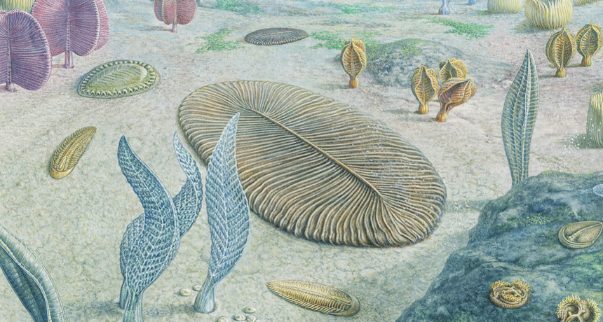
From Neurons to Brains and Behavior
The Steering Breakthrough
Bilateral symmetry → forward motion
Steering = choose direction
Needed more than reflexes
Notes:
Bilateral symmetry made a new kind of behavior possible: steering.
Once animals had a front end, they could put sensors there — light detectors, chemical detectors, touch receptors.
That meant they could move forward and bias their turns left or right based on what those sensors detected.
This is the steering breakthrough: the ability not just to move, but to choose a direction of travel.
But here’s the catch: steering required something more than just a reflex net. T
o choose between competing inputs — food on one side, danger on the other —
animals needed a central place to integrate information and coordinate muscles.
That’s where the first brains appeared.

Slide 8
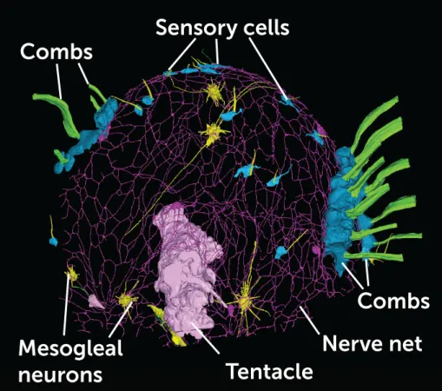
From Neurons to Brains and Behavior
Jellyfish Nervous System
What Is a Nerve Net?
spread evenly
can coordinate
but no central hub
Notes:
So what exactly is a brain?
At its simplest, a brain is a cluster of neurons at the front of the body, specialized for integrating information.
Let’s contrast two examples:
Cnidarians like jellyfish and corals have only a nerve net.
A nerve net spreads evenly through the body, good for local reflexes.
It can coordinate muscle contractions and feeding reflexes, but there’s no central hub — no ‘brain.’
In bilateral animals, we see the first nerve rings —
clusters of neurons at the front of the body, often encircling the gut or pharynx.

Slide 9
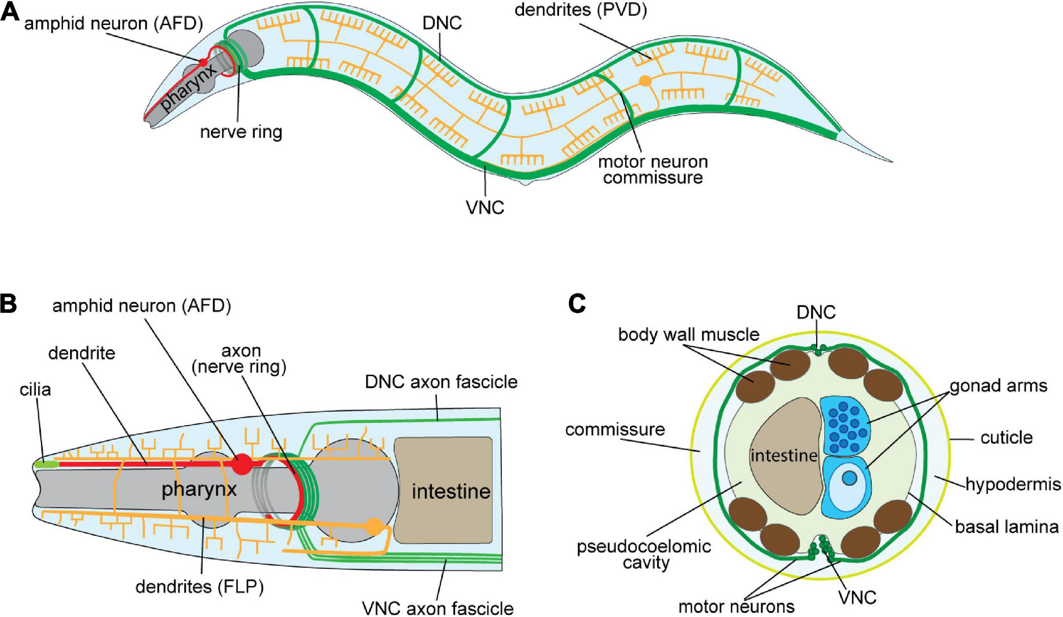
From Neurons to Brains and Behavior
What Is a Brain?
Cluster of neurons at the front
Specialized for integration
Coordinates sensing + movement
Distinct from a nerve net
C Elegans Nervous System
Notes:
A brain brings information together in one place —
especially useful if you’re moving forward and need to quickly compare what’s on the left vs. the right,
or food vs. danger.
Brains don’t just relay signals, they coordinate them.
They combine sensory inputs, internal states, and context to drive one coherent output.
This clustering at the front end — where the sensors are —
is what distinguishes a brain from a diffuse network of neurons.
These nerve rings were the earliest brains.
They allowed animals like early worms to do something new:
Gather sensory information from both sides of the body,
Weigh it against internal needs,
And steer in a coherent direction.
It wasn’t yet thinking as we know it.
But it was already decision-making in a primitive form: choose which way to move, when to feed, when to stop.

Slide 10
From Neurons to Brains and Behavior
Structure of the First Brains
Nerve ring: circular cluster of neurons
Connected to sensory + motor neurons
Ganglia: mini-clusters along body
Role = integration & coordination
C Elegans Nervous System
Notes:
The first brains weren’t big blobs like ours.
They were more like nerve rings —
circular clusters of neurons at the front of the body, often surrounding the gut or pharynx.
These nerve rings connected directly to:
Sensory neurons at the front of the animal, detecting light, chemicals, or touch,
Motor neurons that ran along the body wall, controlling muscles for movement.
In some animals, small additional clusters called ganglia appeared along the body.
These acted as local processing centers, but the nerve ring served as the main hub.
This organization was a big leap from a nerve net: instead of local reflexes everywhere.
there was now a central structure for integration and coordination — the essence of what makes something a brain.

Slide 11
From Neurons to Brains and Behavior
C. elegans as a Model Brain
Tiny worm, 1 mm long
Nervous system = 302 neurons
Nerve ring + ganglia = brain analog
Entire wiring diagram mapped
C Elegans Nervous System
Notes:
A modern animal that gives us a window into the first brains is the nematode Caenorhabditis elegans.
It’s a tiny worm, only about a millimeter long, but it has a complete nervous system of just 302 neurons.
Those neurons form:
A nerve ring around the pharynx, which functions as the worm’s brain,
Additional ganglia along the body, coordinating muscles and reflexes.
C. elegans is special because scientists have mapped its entire connectome — we know every neuron, every connection, every synapse.
Even with so few neurons, C. elegans can:
Steer toward food,
Avoid toxins,
Learn simple associations,
And balance competing needs, like hunger versus danger.
So this tiny worm shows us what the earliest brains could do:
integrate sensory inputs, coordinate motor outputs, and make simple but flexible decisions.

Slide 12
From Neurons to Brains and Behavior
Inside the C. elegans Brain
Nerve ring = integration hub
~180 neurons in the ring
Sensory neurons → interneurons → motor neurons
Connects to muscles for movement
C Elegans Nervous System
Notes:
Let’s take a closer look at how the C. elegans brain is organized.
At the core is the nerve ring, about 180 neurons forming a circular hub around the pharynx.
This ring acts as the worm’s integration center.
The basic flow looks like this:
Sensory neurons at the front detect chemicals, touch, or temperature.
They send signals into the nerve ring, where interneurons weigh and combine those inputs.
From there, motor neurons carry the output signals along the body wall to control muscles.
This is the same basic architecture we’ll see in all later brains: input → integration → output.
Even with so few neurons, the worm can adjust behavior in flexible ways —
turning left or right depending on sensory gradients, stopping or going depending on hunger, and even learning from past experiences.
So, C. elegans gives us a detailed look at what the very first brains were doing —
integrating multiple signals into coordinated movement.

Slide 13
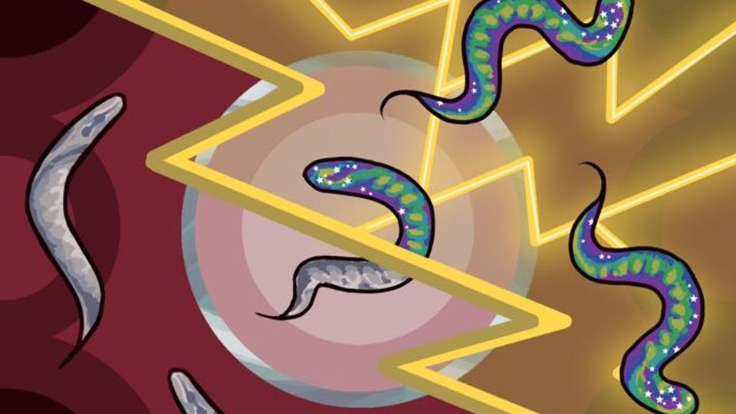
From Neurons to Brains and Behavior
Valence: Good vs. Bad Signals
Valence = “good vs. bad” coding
Positive → approach
Negative → avoid
Basis for decisions
Notes:
At the core of the worm’s brain — and really all brains — is the idea of valence.
Valence is the nervous system’s way of coding things as either positive or negative.
Positive valence means: this is good, approach it — like food, warmth, or safety.
Negative valence means: this is bad, avoid it — like toxins, predators, or pain.
This approach–avoidance coding is the most basic kind of decision-making.
Even in C. elegans, the nerve ring is integrating sensory inputs into a simple choice: move toward or move away.
And just like in humans, this coding isn’t static —
the same thing can shift in valence depending on the animal’s internal state, like hunger or fear.
We’ll get to that next.

Slide 14
From Neurons to Brains and Behavior
Internal States: Hunger and Satiety
Valence depends on state
Hunger → food = stronger “good”
Satiety → food = weaker “good”
Internal states guide choices
Notes:
Valence isn’t just about the outside world — it’s shaped by the internal state of the animal.
Take food as an example:
When a worm is hungry, food cues carry strong positive valence. The worm’s nerve ring biases movement toward them.
When the worm is full, those same cues lose their pull. The worm ignores them or explores elsewhere.
So the brain is doing more than reacting to the environment —
it’s combining sensory inputs with internal needs.
This principle is universal: in humans, hunger makes food smells irresistible; satiety dampens them.
The same is true for other drives like thirst, fatigue, or arousal.
Even the simplest brains show that internal states reshape decision-making.

Slide 15
From Neurons to Brains and Behavior
Managing Trade-Offs: Food vs. Danger
Animals face conflicts
Example: worm + copper barrier
Food on other side
Copper = toxic
Decision: risk vs. reward
Notes:
Life isn’t just simple approach or avoid — it often involves trade-offs.
A classic experiment with C. elegans shows this well:
The worm detects food on the far side of a barrier.
But the barrier contains copper, which is toxic.
Now the worm has to decide: is it worth the risk?
Sometimes it tries to cross.
Sometimes it turns away.
The decision depends on how hungry the worm is, and how strong the food odor is.
This shows that even with just a few hundred neurons, worms can do cost–benefit analysis.
Their little brains are already weighing competing pressures and producing flexible, context-dependent choices.

Slide 16
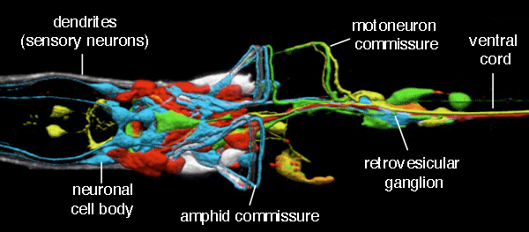
From Neurons to Brains and Behavior
Brains as Integration Centers
Many inputs → one coordinated action
Example: C. elegans nerve ring
Sensory + internal + context → decision
Notes:
These trade-offs show why brains matter — and we can see it clearly in C. elegans.
The worm’s nerve ring is its brain.
Sensory neurons from the head project into the ring, carrying signals about food odors, temperature, and toxins.
Interneurons inside the ring combine those signals with the worm’s internal state —
for example, whether it’s hungry.
Then motor neurons carry the final decision out to the muscles, biasing the worm to approach, avoid, or stop.
So even in this tiny brain of just a few hundred neurons, we can see the core function of all brains:
Integrating many inputs into one coordinated output.
That’s what makes brains more than just wiring — they’re decision hubs.

Slide 17
From Neurons to Brains and Behavior
 |  | Arousal
 |  | High | Low
Valence | Good | Excited | Content
 | Bad | Anxious | Depressed
The Origins of Emotion and Primitive Affective States
Beyond valence: arousal (high ↔ low)
Valence + arousal = basic “mood space”
Shapes flexibility of behavior
Notes:
Brains don’t just code things as good or bad. They also track arousal — how alert or activated the animal is.
Combine these two dimensions and you get a very simple mood space:
Valence tells you whether something is good or bad.
Arousal tells you how strongly you should react right now.
This allows even simple brains to be more flexible:
A hungry worm with high arousal might take risks to cross a toxic barrier for food.
The same worm, less aroused or more satiated, might stay safe instead.
And in humans, we can see the same two-dimensional system at work.
Our moods and emotions can often be mapped into valence and arousal space —
from calm contentment (low arousal, positive valence) to anxious stress (high arousal, negative valence).
These primitive affective states are built from the same basic chemistry across species —
and we can trace them through neurotransmitters.

Slide 18
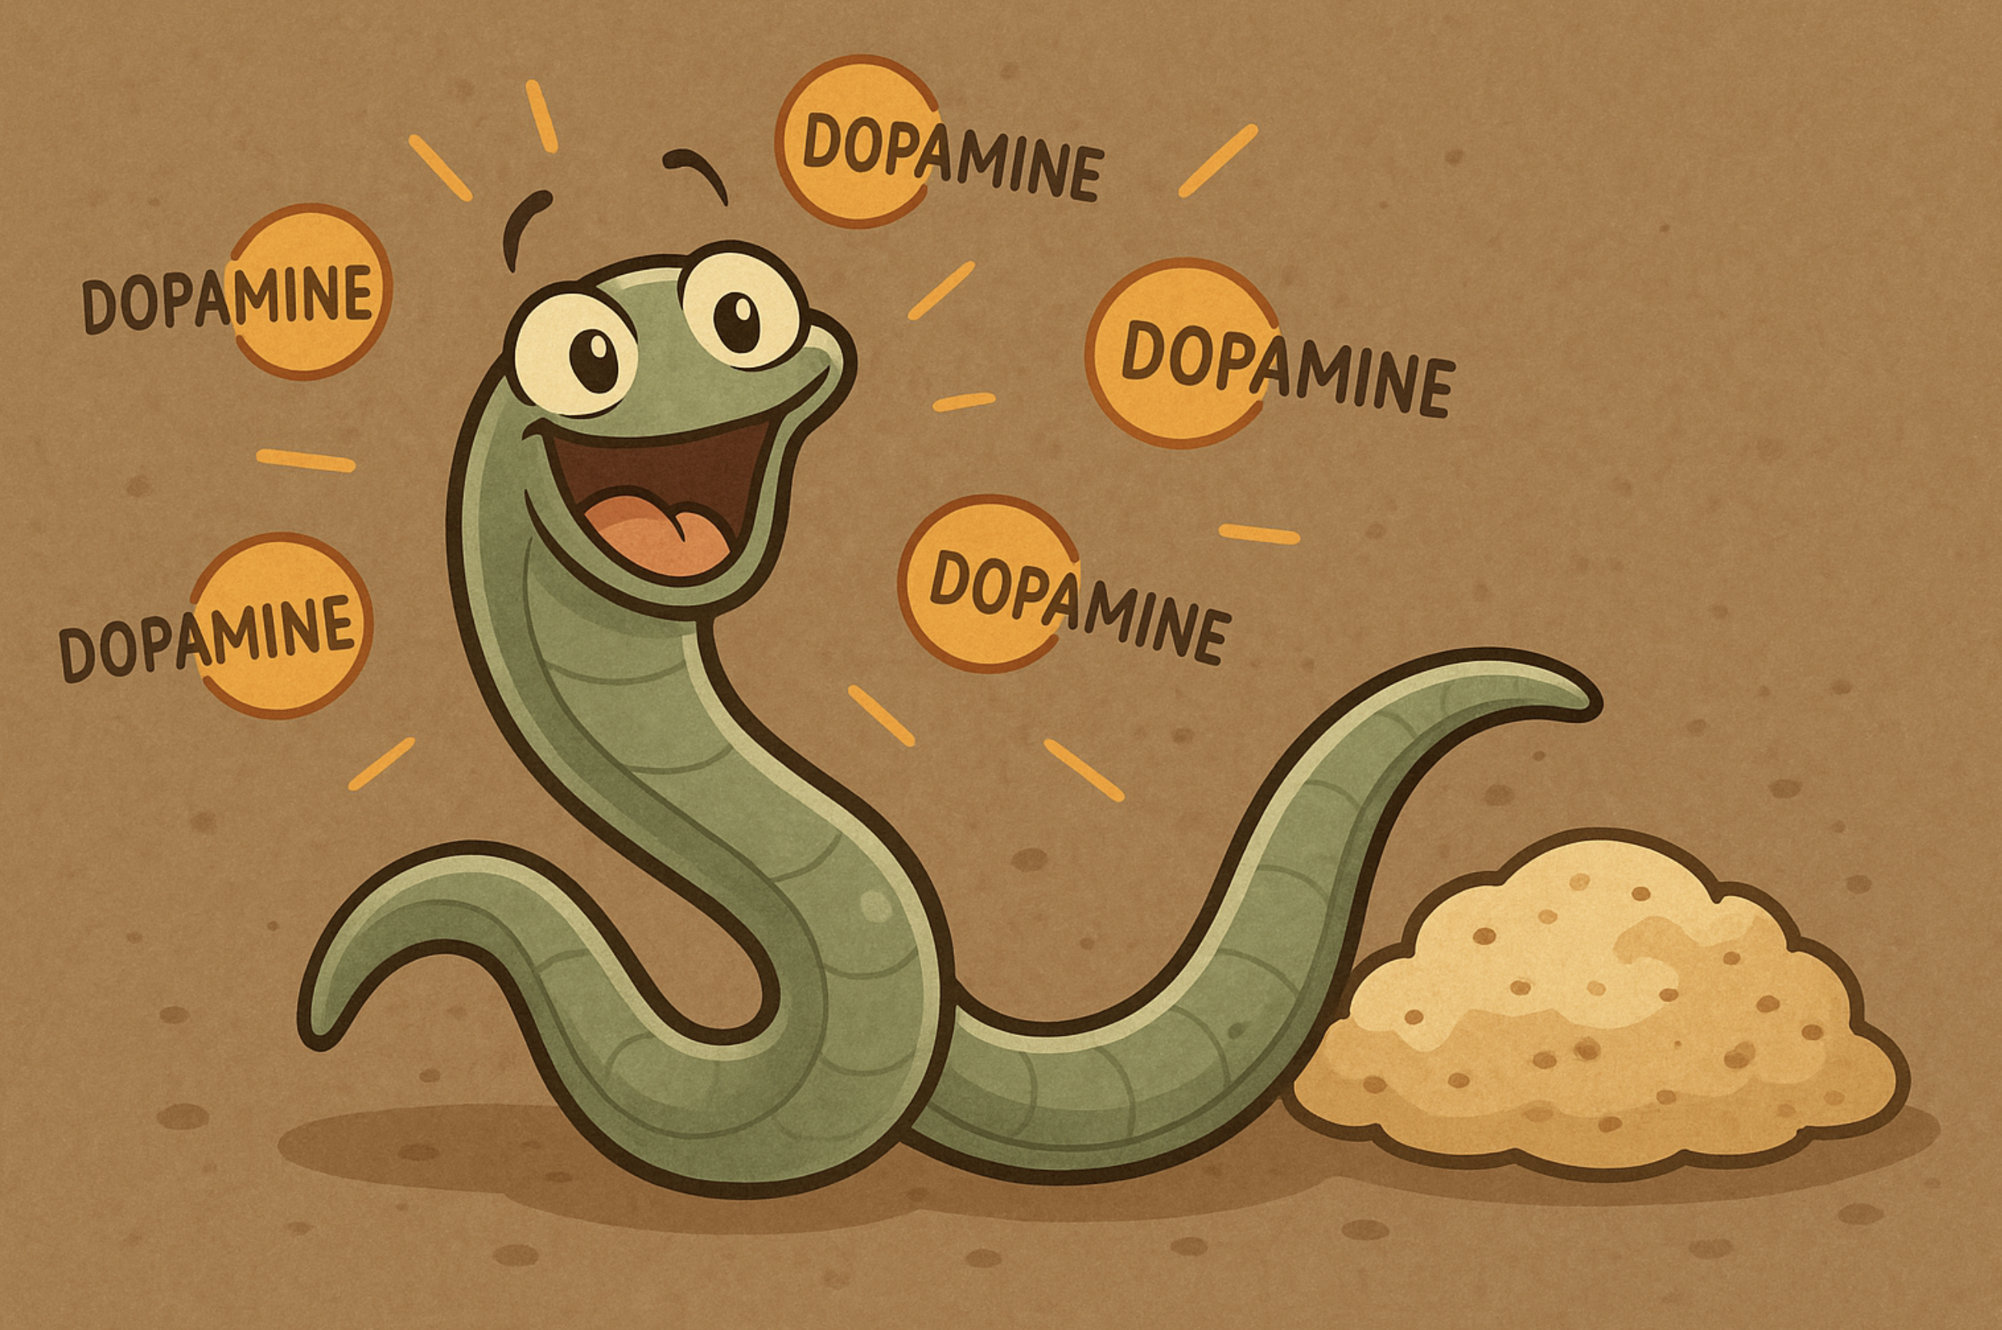
From Neurons to Brains and Behavior
Dopamine: Motivation and Pursuit
Dopamine = “wanting” signal
Drives pursuit of rewards
In worms & humans
Human links: addiction, Parkinson’s
Notes:
Earlier we introduce Glutamate and GABA as two key neurotransmitters for exciting and inhibiting neurons, respectively.
We noted that there are other neurotransmitters with more specialized functions.
Now is the time to introduce some important ones.
One of the key neurotransmitters that shapes valence and arousal is dopamine.
In simple animals like worms, dopamine release is linked to pursuit of positive outcomes —
food, safe environments. It tells the worm: keep going, keep trying.
In humans, dopamine plays the same basic role.
It’s part of our brain’s reward pathway, motivating us to work for rewards. That’s why:
Addictive drugs hijack the dopamine system, making the brain overvalue certain behaviors.
Parkinson’s disease results from dopamine-producing neurons dying, leading to difficulties in movement and motivation.
So across species, dopamine acts as a kind of ‘wanting’ signal, pushing organisms to act in pursuit of rewards.

Slide 19
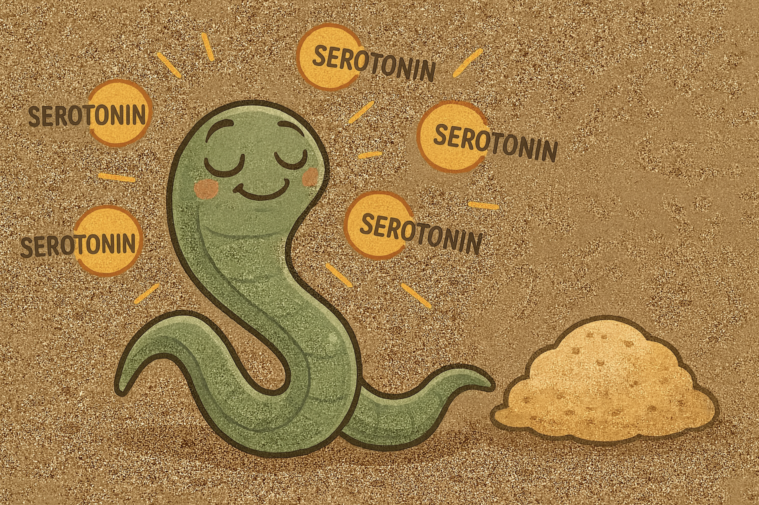
From Neurons to Brains and Behavior
Serotonin: Satisfaction and Mood
Serotonin = “satisfaction” signal
Regulates mood, satiety
Worms & humans
Human links: depression, SSRIs
Notes:
Another key neurotransmitter is serotonin.
In worms, serotonin release is tied to satiety —
once the worm has eaten enough, serotonin signals that it’s time to stop.
In other contexts, serotonin dampens arousal and stabilizes behavior.
In humans, serotonin plays a major role in regulating mood and satisfaction.
Low serotonin activity has long been associated with depression.
That’s why many antidepressant medications, called SSRIs (selective serotonin reuptake inhibitors), work by increasing serotonin’s availability at synapses.
So while dopamine drives us to keep wanting and pursuing,
serotonin tells us when to be satisfied and helps regulate our emotional balance.
Even in simple worms, these roles are already visible.
Don’t think of serotonin as the chemical that causes low arousal.
Instead, it’s a regulator that helps stabilize mood.
When it’s out of balance, the whole valence–arousal system can go wrong —
which is why low serotonin has been linked to depression.

Slide 20
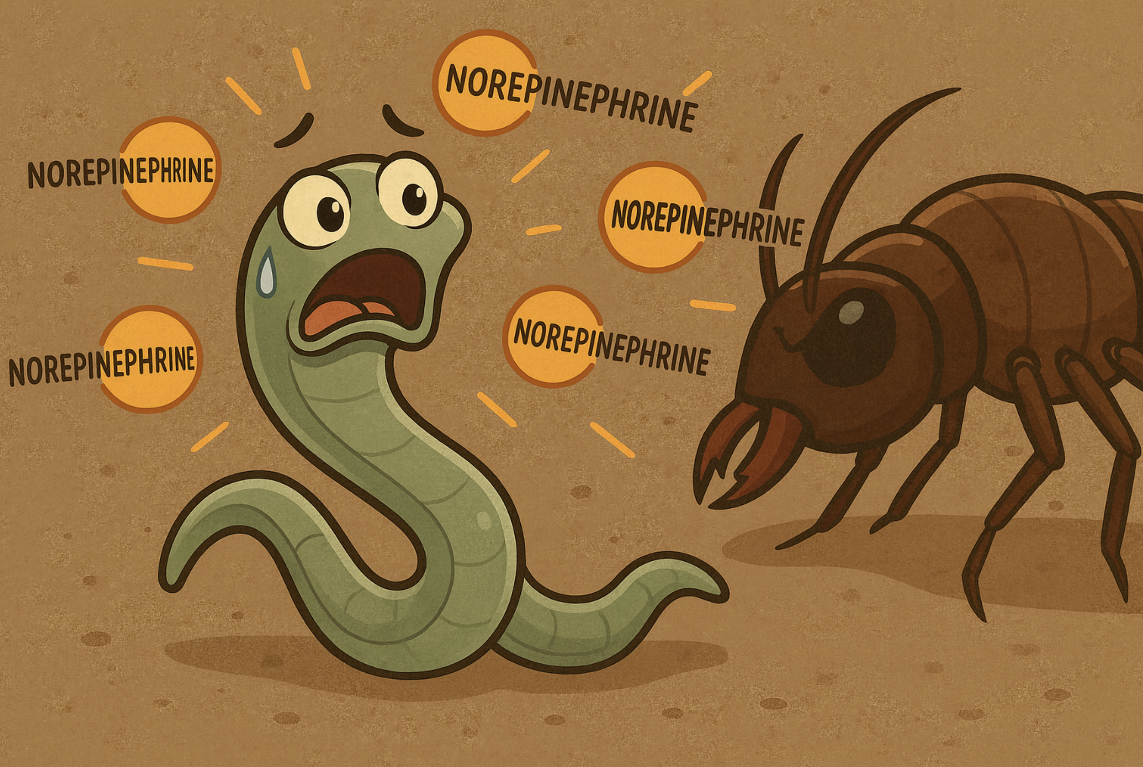
From Neurons to Brains and Behavior
Stress and Arousal Systems
Norepinephrine = alert, fight-or-flight
Stress signals: prepare to act
Endorphins/opioids = calm, recovery
Human links: anxiety, PTSD, pain relief
Notes:
Brains also regulate stress and arousal systems.
One major player is norepinephrine (also called noradrenaline).
It ramps up arousal — the classic ‘fight-or-flight’ response.
In animals, it prepares the body to act quickly.
In humans, overactive norepinephrine signaling is linked to anxiety disorders and PTSD.
But stress systems also include brakes.
Endorphins and other opioid-like neurotransmitters help calm the system down after danger passes.
They provide pain relief and a sense of recovery.
In humans, this is what underlies phenomena like the ‘runner’s high’ —
as well as the dangerous addictive effects of opioid drugs.
So even the simplest brains balance activation and recovery.
They need both the accelerator and the brakes to keep behavior adaptive.

Slide 21
From Neurons to Brains and Behavior
 |  | Arousal
 |  | High | Low
Valence | Good | Excited | Content
 | Bad | Anxious | Depressed
Valence × Arousal (Revisited)
Notes:
Let’s come back to our valence × arousal chart,
and think about how the neurotransmitters we’ve just discussed help regulate this space.
Dopamine is strongly tied to positive valence and higher arousal.
It motivates pursuit and action.
When dopamine is overactive, we can see too much drive — as in addiction.
When it’s underactive, there’s a lack of motivation, as in Parkinson’s disease.
Serotonin acts more like a stabilizer.
It helps regulate mood and dampen extremes of arousal. Low serotonin doesn’t simply mean ‘low arousal’ —
it means the system can’t stabilize,
leaving people vulnerable to getting stuck in negative-valence states, as in depression.
Norepinephrine is linked to arousal, especially in the negative direction —
preparing the body for fight-or-flight.
Too much norepinephrine is associated with anxiety and stress disorders.
So, you can think of these neurotransmitters as different knobs that tune this 2D affective space.
They don’t map perfectly onto a single quadrant,
but they help us understand how brains move through this space —
and why imbalances can land people in problematic states like depression or anxiety.

Slide 22
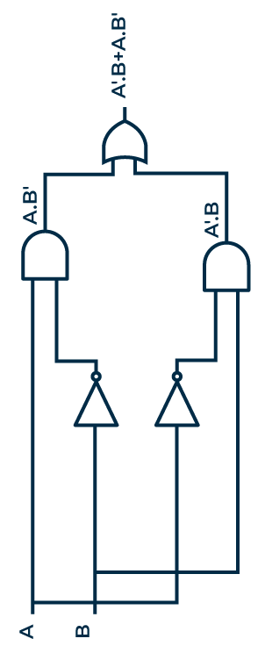
From Neurons to Brains and Behavior
Today we saw…
From nerve nets → first brains (nerve rings)
C. elegans: 302 neurons, real decisions
Valence + arousal = primitive moods
Dopamine, serotonin, stress systems in worms & humans
Next time…
Brains aren’t just neurons firing randomly
Neurons wired in circuits performing complex computations
Circuits can implement logic (AND, OR, IF)
Foundations of computation in the brain
Notes:
Let’s wrap up.
Today we traced how brains emerged from nerve nets,
with worms like C. elegans giving us a modern window into what the first brains looked like.
Even with just 302 neurons, they show integration, trade-offs, and simple decision-making.
We saw how brains use valence and arousal to code the world in terms of approach and avoidance,
and how those same systems —
dopamine, serotonin, stress neuromodulators —
play roles in human mood, motivation, and mental health.
But brains aren’t just a jumble of neurons firing.
They’re circuits, wired in specific patterns.
And those circuits can implement logic: AND, OR, IF — the same building blocks we studied earlier in our logic unit.
That’s where we’ll go next: from neurons to circuits to computation.

